Slide 1

Learning Management system in Facebook v3.0
TEAM: JOAO GUIMARAES, DANIEL RODRIGUEZ
PRODUCT OWNER: DR. ALEJANDRO ARRIETA
PROFESSOR: DR. MASOUD SADJADI

Slide 2
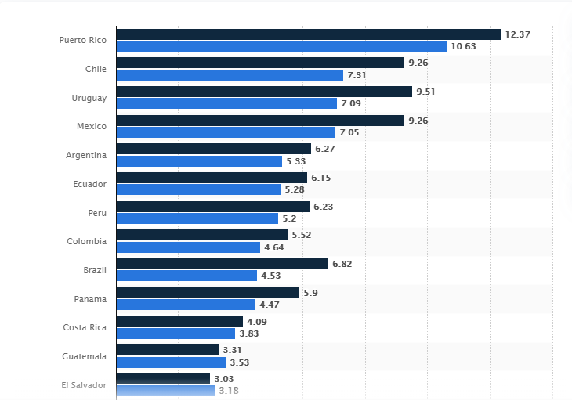
The Problem?
The arms race between data-size and internet speed is problematic, especially for individuals in countries with poor internet connection. This is a specifically prevalent issue for individuals who are trying to expand their knowledge and international students who want to engage with an online course effectively and efficiently.
In our project, we attempted to help remediate this problem.

Slide 3
The Solution
Newest Technologies
SPA
3-Tier Architecture
Cloud-based Database

Slide 4

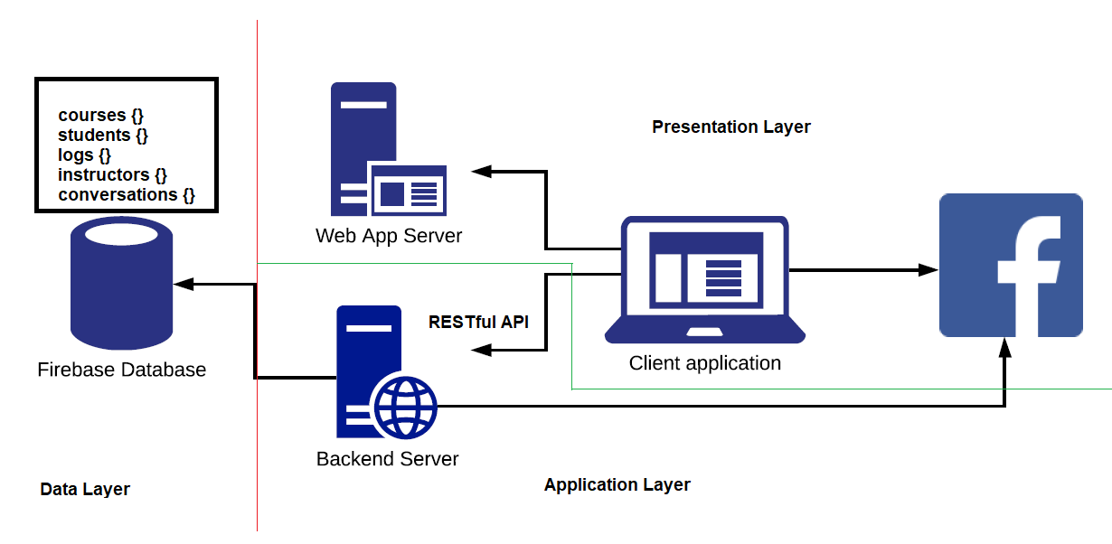
Basic System Decomposition
3-Tier Architecture
Presentation Layer
Application/
Business layer
Data Layer

Slide 5

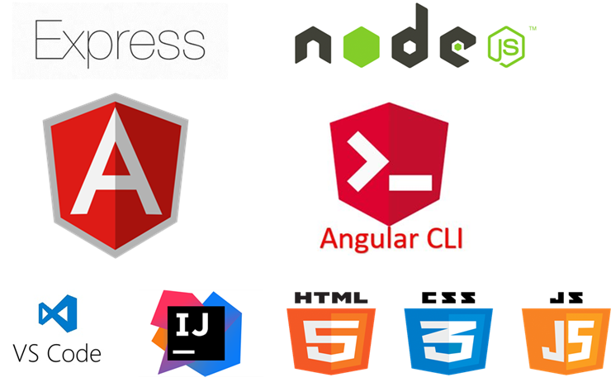
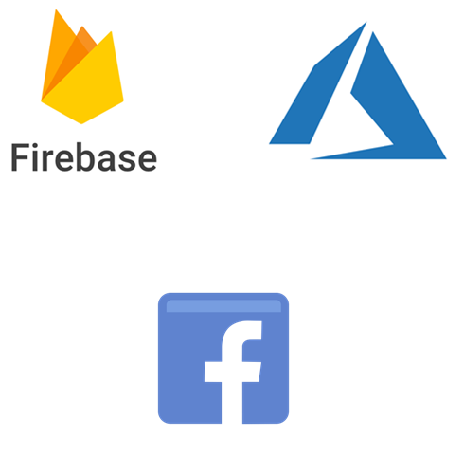
Technologies used
Front-end

Slide 6




Requirements
STUDENTS SHOULD BE ABLE TO REGISTER FOR, AND VIEW COURSES.
STUDENTS SHOULD HAVE ACCESS TO A VARIETY OF COURSE MATERIALS, SUCH AS PDFS, VIDEOS AND QUIZZES.
ADMINS SHOULD BE ABLE TO LOGIN, CREATE AND EDIT COURSES.
ADMINS SHOULD BE ABLE TO MANAGE COURSE MATERIALS AND STUDENTS.

Slide 7
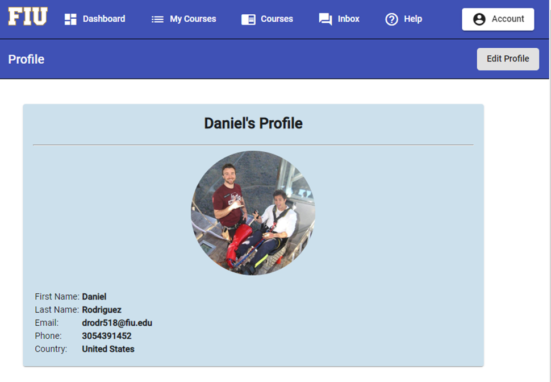
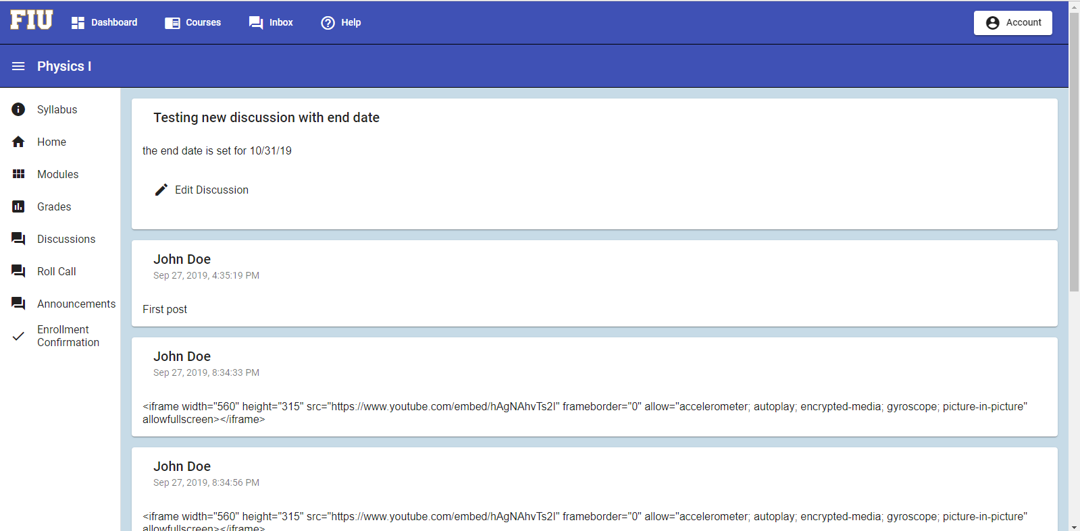
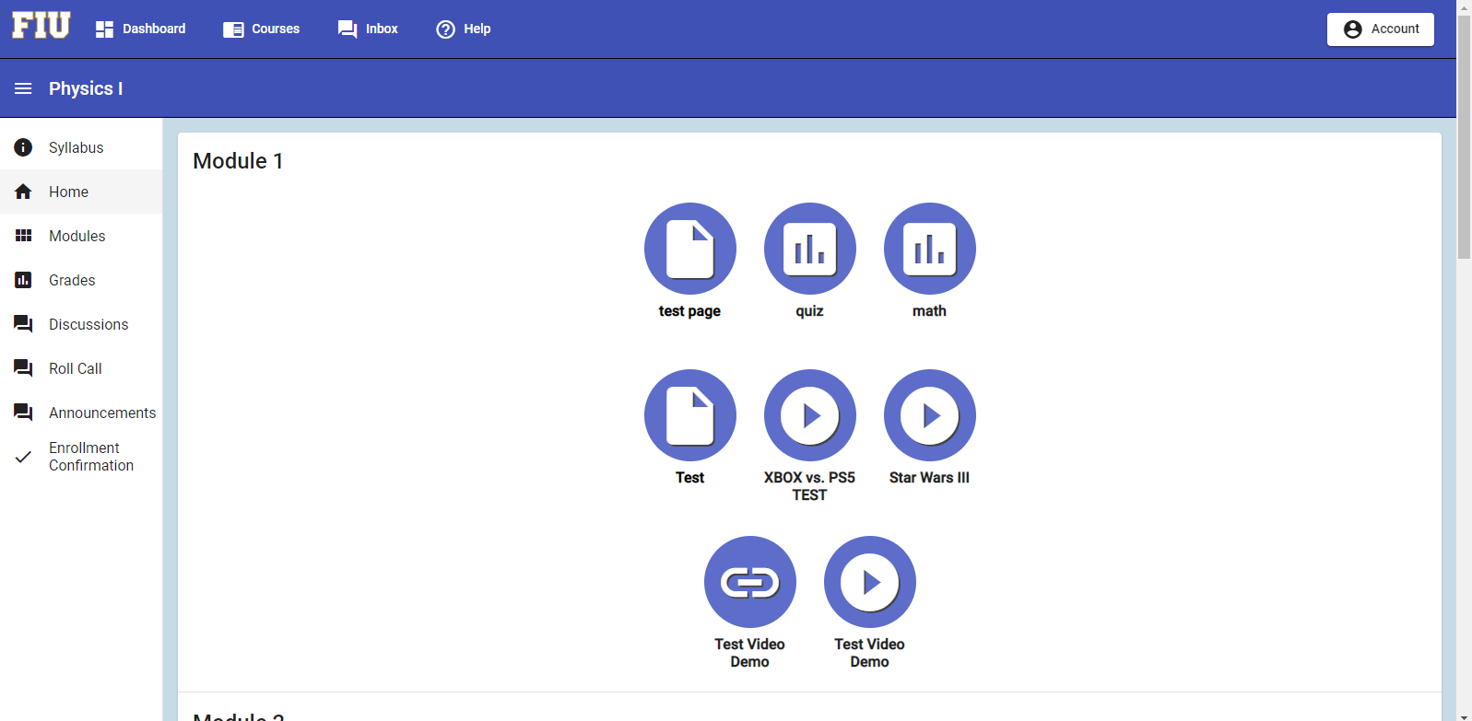
A Visual

Slide 8
Thank You
TEAM: GABRIEL FAJARDO, IAN CUVALAY
PRODUCT OWNER: DR. ALEJANDRO ARRIETA
PROFESSOR: DR. MASOUD SADJADI

